Slide 1

Chandigarh School of Business, Jhanjeri
Department of Computer Application
Program Code:NA
Program Name: MCA
Course Code: PGCA1937
Course Name: Cloud Computing
Prepared by: Dr. Gurvir Kaur

Slide 2

Outlines
PTU Syllabus of Unit-I
CO’s Introduction
Topic Overview
Brief description of what the presentation will cover
Importance or relevance of the topic
Key objectives or learning outcomes
Summary
References

Slide 3
PTU Syllabus of Unit-I
Part-A
Overview of Computing Paradigm: Recent trends in Computing -Grid Computing, Cluster Computing, Distributed Computing, Utility Computing, Cloud Computing.
Introduction to Cloud Computing: Vision of Cloud Computing, Defining a Cloud, Cloud Reference Model, Deployment Model, Characteristics, Benefits of Cloud Computing, Challenges ahead. Cloud computing vs. Cluster computing vs. Grid computing.
Migrating into a Cloud: Introduction, Broad approaches to Migrating into the Cloud, The Seven-Step Model of Migration Into a Cloud.
Virtualization: Introduction, Characteristics of Virtualized environment, Taxonomy of Virtualization techniques, Virtualization and Cloud Computing, Pros and Cons of Virtualization, Technology Examples- Xen, VMware, Microsoft Hyper-V.
Capacity Planning: Introduction, Defining Baseline and Metrics-Baseline Measurements, System Metrics, Load Testing, Resource Ceilings, Server and Instance types; Network Capacity, Scaling.

Slide 4
Key objectives or learning outcomes
CO1 Understand the basic concept and importance of cloud computing.
CO2 Access the suitability of migrating to a cloud solution for different applications.
CO3 Compare and evaluate the virtualization technologies.
CO4 Monitor and manage the cloud resources, applications and data while addressing the security concerns.
CO5 Use cloud solutions offered by industry leaders for various applications.

Slide 5
CO Introduction
CO NUMBER | TOPICS | LEVEL
CO1 | Overview of Computing Paradigm: Recent trends in Computing -Grid Computing, Cluster Computing, Distributed Computing, Utility Computing, Cloud Computing. Introduction to Cloud Computing: Vision of Cloud Computing, Defining a Cloud, Cloud Reference Model, Deployment Model, Characteristics, Benefits of Cloud Computing, Challenges ahead. Cloud computing vs. Cluster computing vs. Grid computing. | 2

Slide 6
Topic Overview
Evolution and Integration: Recent trends in computing, such as Grid Computing, Cluster Computing, and Distributed Computing, focus on optimizing resource utilization across multiple systems.
These paradigms enable parallel processing and resource sharing, improving performance, scalability, and fault tolerance.
Grid Computing uses distributed resources to solve complex tasks, Cluster Computing groups tightly coupled systems for enhanced performance, and Distributed Computing splits workloads across geographically dispersed networks.

Slide 7
Brief of what the presentation will
The presentation will cover the following points:
Introduction to Cloud Computing
Grid vs. Cloud computing
Cluster vs. Grid computing
Grid vs. cluster vs. cloud computing

Slide 8
Importance of the topic
Scalability and Flexibility: Cloud computing provides on-demand access to a vast range of resources, enabling businesses to scale up or down based on their needs.
Cost Efficiency: By using cloud services, businesses can significantly reduce costs associated with maintaining and upgrading physical hardware.
Accessibility and Collaboration: Cloud computing allows users to access data and applications from any device with an internet connection, facilitating remote work and global collaboration. This enhances productivity, supports flexible work environments, and enables real-time collaboration across teams and locations.

Slide 9
Detail Topics
The ACM Computing Curricula 2005 defined "computing" as
"In a general way, we can define computing to mean any goal-oriented activity requiring, benefiting from, or creating computers. Thus, computing includes designing and building hardware and software systems for a wide range of purposes; processing, structuring, and managing various kinds of information; doing scientific studies using computers; making computer systems behave intelligently; creating and using communications and entertainment media; finding and gathering information relevant to any particular purpose, and so on. The list is virtually endless, and the possibilities are vast."

Slide 10
Cloud Computing?
Small as well as large IT companies, follow the traditional methods to provide the IT infrastructure. That means for any IT company, we need a Server Room that is the basic need of IT companies.
In that server room, there should be a database server, mail server, networking, firewalls, routers, modem, switches, QPS (Query Per Second means how much queries or load will be handled by the server), configurable system, high net speed, and the maintenance engineers.
To establish such IT infrastructure, we need to spend lots of money. To overcome all these problems and to reduce the IT infrastructure cost, Cloud Computing comes into existence.

Slide 11
Grid Vs Cloud
Resource distribution: Grid is a decentralized cloud computing is a centralized.
Administration : Grid have many administrative domains. Cloud computing has a single administrative domain.
Ownership: Grid is owned by multiple parties in multiple locations. Cloud computing is a collection of computers usually owned by a single party.

Slide 12
Cluster vs Grid Computing
Cluster Computing
A cluster computer refers to a network of same type of computers whose target is to work as a same unit. Such a network is used when a resource hungry task requires high computing power or memory. Two or more same types of computers are clubbed together to make a cluster and perform the task.
Grid Computing
Grid computing refers to a network of same or different types of computers whose target is to provide a environment where a task can be performed by multiple computers together on need basis. Each computer can work independently as well.

Slide 13
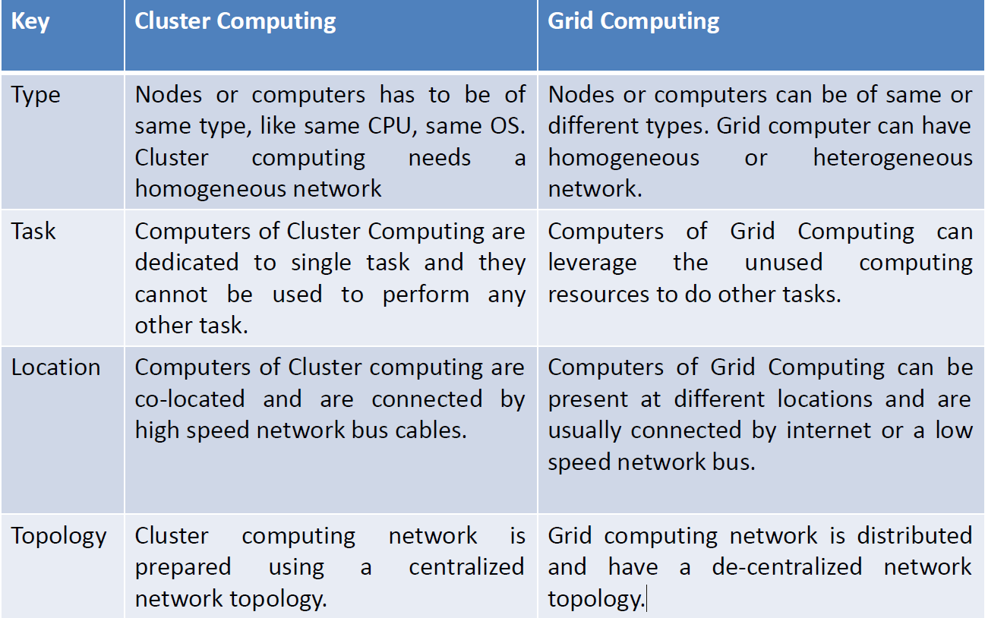
Cluster vs Grid Computing

Slide 14
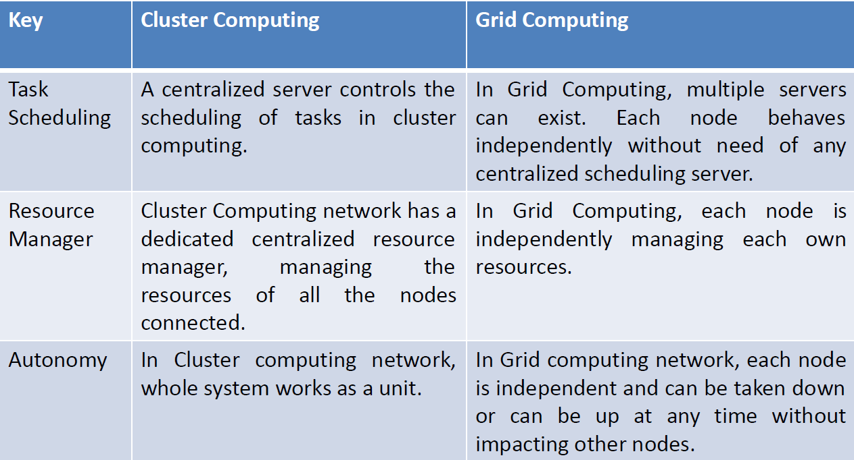
Cluster vs Grid Computing

Slide 15
Cluster Vs Grid & Cloud computing
Cluster is a group of computers connected by a local area network (LAN)
Grid and Cloud are more wide scale and can be geographically distributed (WAN)
Cluster is a Tightly coupled , made up of machines with similar hardware and OS.
Grid and cloud are Loosely Coupled and made up of machines with different hardware configurations and OS.
Cluster is a Homogeneous and Grid & Cloud are Heterogeneous.

Slide 16
Summary
Cloud Computing: Primarily used for applications requiring flexible, on-demand access to computing resources (e.g., web hosting, data storage, SaaS).
Grid Computing: Often used for scientific, research, or large computational tasks where diverse resources are pooled together for solving complex problems (e.g., simulations, data analysis).
Cluster Computing: Focuses on providing high-performance computing for intensive applications like scientific simulations, rendering, and data processing in a controlled environment.

Slide 17
References
Books References
Mastering Cloud Computing, Rajkumar Buyya, Christian Vecchiola, and ThamaraiSelvi, Tata McGraw Hill, ISBN-13: 978-1-25-902995-0, New Delhi, India,Feb 2013.
E-book link
https://archive.org/details/cloudcomputingbi0000sosi
YouTube link
https://www.youtube.com/@cloudcomputing351/videos
https://www.geeksforgeeks.org/cloud-computing/
https://www.tutorialspoint.com/cloud_computing/index.htm
https://nptel.ac.in/courses/106105167
https://www.edx.org/learn/cloud-computing

Slide 18
THANK YOU

